Slide 1
Sampling
Notes:
What is sampling?

Slide 2
Sampling
Examples – in folder
http://ncss-tech.github.io/stats_for_soil_survey/chapters/3_sampling/3_sampling.html
Exercise/examples
https://github.com/ncss-tech/stats_for_soil_survey/tree/master/data/sampling
Sampling_Excel_example1.xlsx

Slide 3
Sampling
What does that mean to you?

Slide 4
Start with something you want to know more about
sample
-> model
-> predict
Assumes no prior knowledge
Or you can iterate and check your knowledge….. We’ll come back to this idea in the validation section
Notes:
I’m talking about the generic idea of sampling (not the soil specific collection of specimens).

Slide 5
How tall is the class (in inches)?
Let’s start by asking a question
If we were in class we might
Stand up
Look around
And think………….
We can’t see the rest of the class, so what do we do?
Notes:
All scientific endeavors start by asking a question: sampling comes in when you try to answer that question.
Since we aren’t in a physical class you can’t do all this – we could ask everyone.
Open the sampling_Excel_example1.xlsx and look at the DATA sheet from a previous class.

Slide 6
How tall is the class?
Think about how you could most efficiently answer this question
What data do you need?
How do you gather that data?
What will your answer mean?

Slide 7
Population
The thing we are interested in
The complete collection of observations we want to study
What population does this class represent?
How would we define the population of a soil?
Notes:
Taxonomically is one way, Geographically might be another. Components are used to aggregate information in NASIS.

Slide 8

How do we say things about a population?
Sampling
Inference
Notes:
We’ll start by thinking about sampling – which is a little more straightfoward. The next 5 slide are about idealized sampling – this is not done very often by soil survey; but it will help us to think about the ideal before we turn it around and apply the results of samples we already have.

Slide 9
Sample
A subset of a population
Sampling unit (one sample) - The thing we actually observe or collect
Assuming our population of interest is our class: How would you sample your class to get representative data?
Cluster
– by groups
Randomly
Systematically
Notes:
The simplest way to sample is randomly – draw names out of a hat.
Assuming, you were randomly assigned to tables/groups. We could quiz one group/table and get a reasonable representation of the entire class.
Systematically - list names in alphabetical order and systematically (for example, every fifth name) select a sample (this assumes that there is no relationship between the alphabetical rank and the thing we’re interested in).

Slide 10
Sample
A subset of a population
How would you sample a soil?
Randomly
Select random
x–y points within the field
Systematically
Select points on a 20m grid
Two-phase or Cluster
randomly select areas then collect multiple samples within that area
Notes:
Random - The simplest way to sample is randomly – draw names out of a hat.
Systematically - list names in alphabetical order and systematically (for example, every fifth name) select a sample (this assumes that there is no relationship between the alphabetical rank and the thing we’re interested in).
Cluster - Assuming you were randomly assigned to groups, we could quiz one group and get a reasonable representation of the entire class.

Slide 11
Randomly

Slide 12
Systematically
Notes:
A regular, repeating pattern

Slide 13
Systematic: Transect
Notes:
Transects are a type of systematic sample. The difficulty with transects is selecting a distance that captures the variability present and does not miss things that occur in a repeating pattern.

Slide 14
Clusters
Notes:
A cluster is any sampling scheme that concentrates sampling geographically. Within a cluster, samples can be collected systematically (1), or randomly (2 and 3).

Slide 15
Polygon A
Transects
Polygon C
Polygon B
Notes:
Collecting samples on multiple delineations is are an example of cluster sampling. Systematic (transects) or random samples could be used.

Slide 16
Randomly: Stratified Random
Notes:
Stratified random – select one sample from each group. This would be ideal if there was some relationship between group and the thing we’re measuring. In soil survey, it can be used to break the landscape into segments and then randomly selects a point within each. This maintains randomness (unbiasness) but ensures that samples are spread out over the landscape. Stratification can be used to choose polygons and/or to choose points within a polygon.

Slide 17
Why do I keep using the word random?
Bias: tendency or preference that interferes with the ability to be impartial or objective
randomness avoids bias
Examples of Bias in soil sampling..?
taking all your samples no more than 10 feet from a road.
Notes:
Standard statistical tests are based on an assumption that samples are randomly drawn from a population.
Sometimes sampling near roads provide a lot of bias (think rough terrain with few roads); in other situations the roads are laid out in a regular gird (PLSS) and don’t provide bias.

Slide 18
A note on bias
Bias isn’t all bad
When we direct samples to an area to capture the variability
This is model directed sampling
However……….. we need to be careful, documenting the how and why
GIS can help with this a lot
How representative is that area you directed your sampling towards
Notes:
Your conceptual model of soil formation and soil property distribution is used to direct sampling.

Slide 19
The other side of the coin
Inference
Sampling

Slide 20
Inference Space
The conceptual space (or population) to which the results of a study can be applied (or the population to which statistical inferences can be made)
What will the inference space of our class questions be?
Notes:
Do they apply to your entire building? All soil scientists? NSSC? The entire country, or some smaller demographic.

Slide 21
Why do we care?
We want to be right
Match data to the appropriate soils or conditions
We want to be efficient
We have limited resources
Notes:
Thinking about sampling and inference is a natural extension of thinking about soils and map units. In order to properly gather data, or apply data we already have – we need to think about sampling and inference.

Slide 22
Why do we care?
Sampling and Inference Space go hand in hand:
You need to sample an area
Where do you sample to ensure that it represents an area or condition well?
You may already have samples
What do the properties of those samples represent?

Slide 23
Example: a neighborhood with 4 yards
Inference Space: Yard A
Yard A
Yard B
Yard C
Yard D
Inference Space: Yards C and D
Inference Space: entire neighborhood
Notes:
It is simplest to visualize this with geographic groups; but these concepts also apply to feature space (ancillary variables)
Yards are similar to management systems or treatments, but conceptually they could be any feature that separates the world into populations.

Slide 24
Inference Space
Statistically – you can only make an inference from a sampled population
Defining the population is important and involves considered expert opinions of the scientists involved
Yard A
Yard B
Yard C
Yard D

Slide 25
Inference Space
Statistically – you can only make an inference from a sampled population
Defining the population is important and involves considered expert opinions of the scientists involved
Are yards a good way to define this population?
Yards likely account for management differences.
Yard A
Yard B
What don’t they account for?
Yard C
Yard D

Slide 26
Inference Space
Statistically – you can only make an inference from a sampled population
Ideally statistically valid samples should be selected randomly (there are many techniques for doing this)
Is this how most soils are sampled for NRCS?

Slide 27
Inference Space
Is this how most soils are sampled for NRCS?
Statistically – you can only make an inference from a sampled population
Ideally statistically valid samples should be selected randomly (there are many techniques for doing this)
Typically, we use our soil forming model to determine where to sample. (sometimes called purposive sampling)
This type of sampling needs to be well documented – what model was used, why was a sample collected in that location…
This serves us well for mapping, but when we’re using the data for other purposes we need to think about how samples were selected and what that means.
Model Directed Sampling

Slide 28
Design based vs. Model based Sample Selection
Design based – uses inference to establish structure
Samples must have a random component (stochasticity)
‘Classic’ sampling statistics (what we’ve discussed
Model based – assumes the underlying structure is understood
Samples need not be random (the value is a random realization of the underlying processes)
Notes:
The terminology can be a little confusing. For more information:
Brus and dr Gruijter. 1997. Random sampling of geostatistical modellig? Choosing between design-based and model-based sampling strategies for soil (with discussion). Geoderma 80:1-44. doi:10.1016/S0016-7061(97)00072-4 http://www.sciencedirect.com/science/article/pii/S0016706197000724
If you really want to nerd out http://www.ncbi.nlm.nih.gov/pmc/articles/PMC2856970/

Slide 29
Design based vs. Model based Inference
Design based –
Predictions apply to areas
Errors are based on the estimation error (sampling error)
Model based –
Predictions apply to the points (at the block or support scale – or minimum scale of measurement/observation)
Errors are based on the random elements of the model
Notes:
This stuff makes my brain hurt: but the simple take home is that both methods are valid in both directions (sampling and inference).
Consider Viscarra Rossel et al., 2016. Baseline estimates of soil organic carbon by proximal sensing: Comparing design-based, model-assisted and model-based inference. Geoderma 265: 152 – 163. http://www.sciencedirect.com/science/article/pii/S0016706115301312

Slide 30
Yard A
Yard B
Gamma
Alpha
Yard C
Yard D
Beta
Notes:
Add a soil map to our fictional yards. How well are our original samples likely to apply?

Slide 31
Now with expert knowledge we’ll reevaluate inference space for the yard C and D samples.
Yard A
Yard B
Gamma
Alpha
Yard C
Yard D
Beta
What is the inference space?
Where do the results of the analyses apply?
Notes:
The answer to these questions will depend on the differences in management between the yards AND the differences in the soil map units.

Slide 32
Inference Space
Pragmatically – you can argue for an expansion of the inference space through expert knowledge
Existing soil maps or models
Yard A
Yard B
Gamma
Alpha
Yard C
Yard D
Beta

Slide 33
Inference Space
Pragmatically – you can argue for an expansion of the inference space through expert knowledge
Existing soil maps or models
You are the expert: use available information and your knowledge of the distribution of soils to determine:
what portion of the landscape any given set of samples represents
Where do I need to sample to have representative knowledge of the area
Yard A
Yard B
Gamma
Alpha
Yard C
Yard D
Beta

Slide 34
Class Exercise
Class height – this is a summary stats, sampling and inference exercise

Slide 35
Volunteers – Class Height
Random | Systematic | Cluster
Look at Sampling_excel_example1.xlsx for an example of these techniques
https://github.com/ncss-tech/stats_for_soil_survey/blob/master/presentations/sampling_Excel_example1.xlsx

Slide 36
How tall is the class?
Let’s take a few minutes to determine what you think the height of the class (from the example) is.

Slide 37
How tall is the class?
What strategy did you use?
What are the benefits/drawback?
Type locations
Median approach
Sample
There are usually tradeoffs between efficiency and the amount of information obtained.

Slide 38
How tall is the class?
Look at the next sheet
Sampling ht. -class participat
Scroll right and look at the different sampling techniques
Random
Systematic
Two-phase or Cluster

Slide 39
How tall is the class?
Could we have measured everyone?
Was it faster to use a sample?
Was it faster to use a model?
What are the tradeoffs between the two?
What inferences can we make from of our class?

Slide 40
Using Available Remotely Sensed Data to Develop an Unbiased and Representative Sampling Design
Conditioned Latin Hypercube Sampling

Slide 41
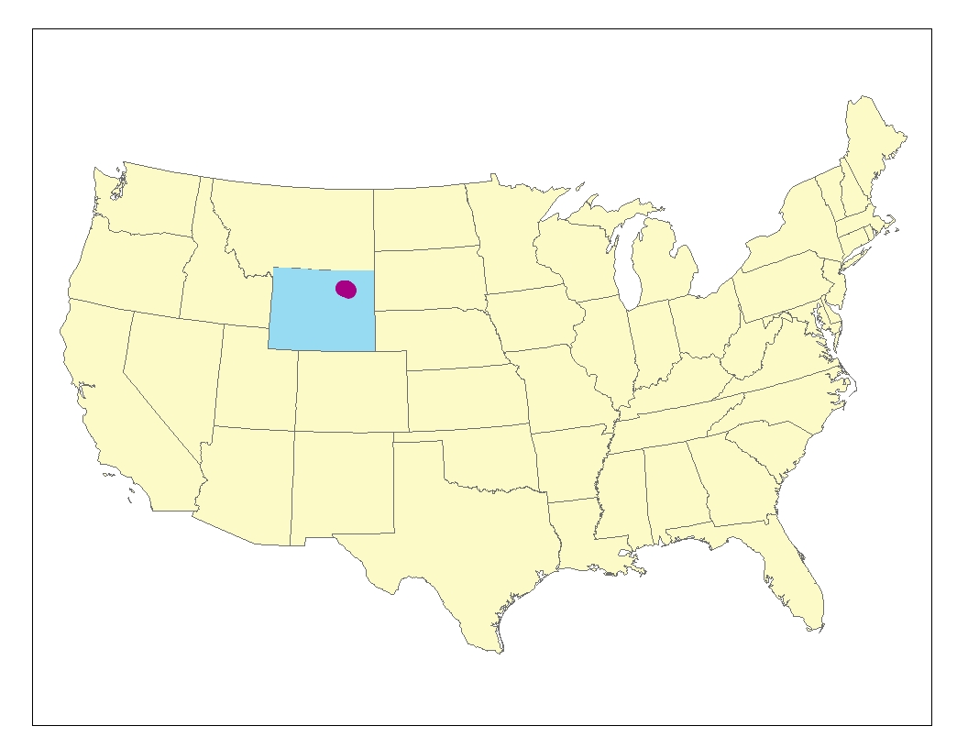
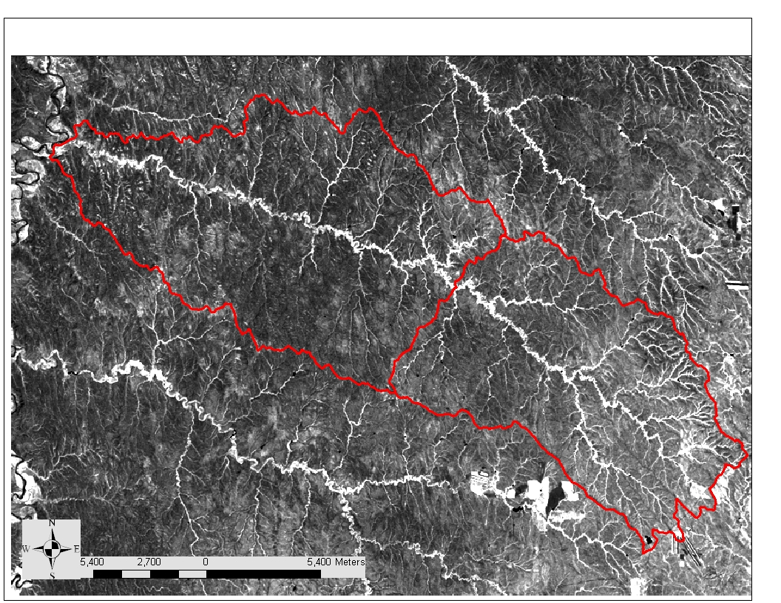
Notes:
I’ll start with an example from Wyoming. We had a good deal of remotely sensed information and wanted a statistical (probability based) sampling scheme.

Slide 42
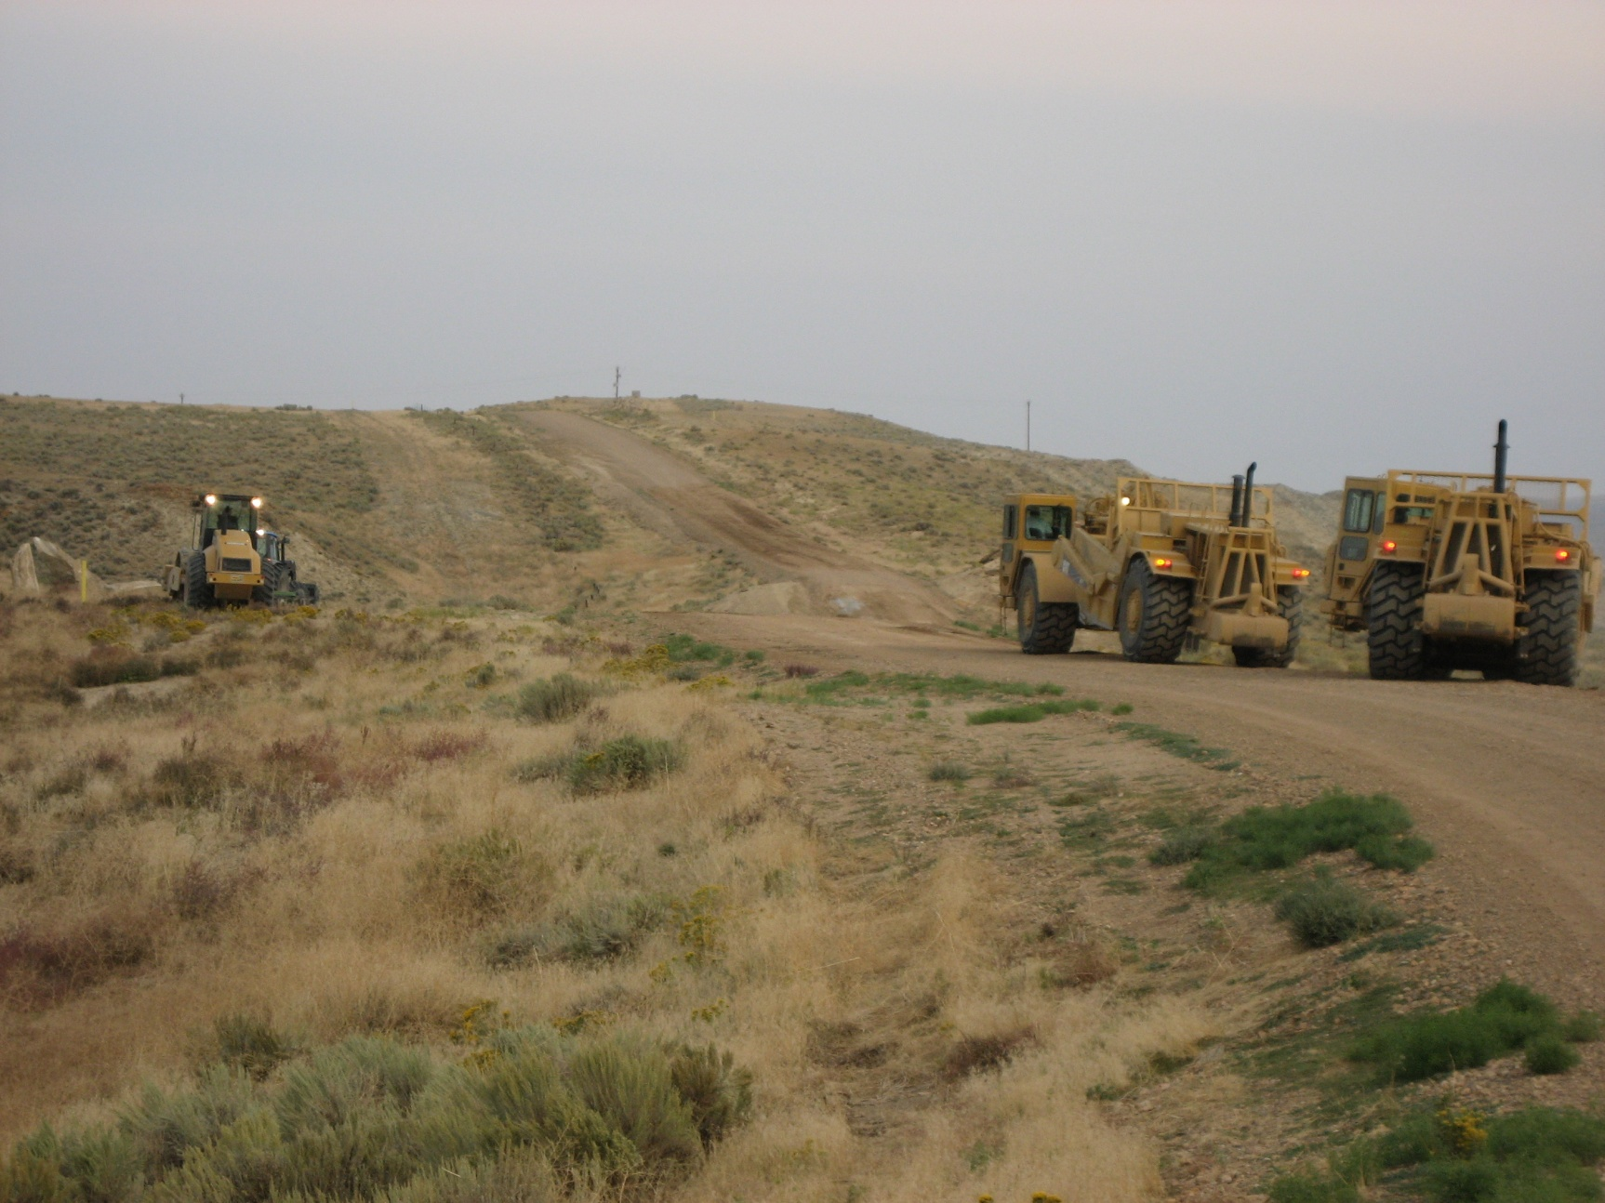
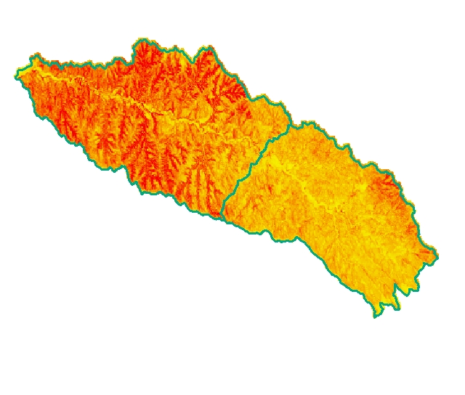
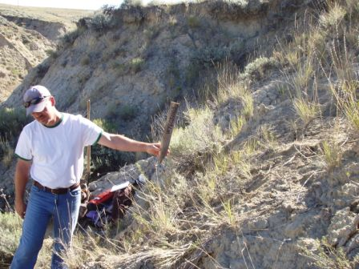
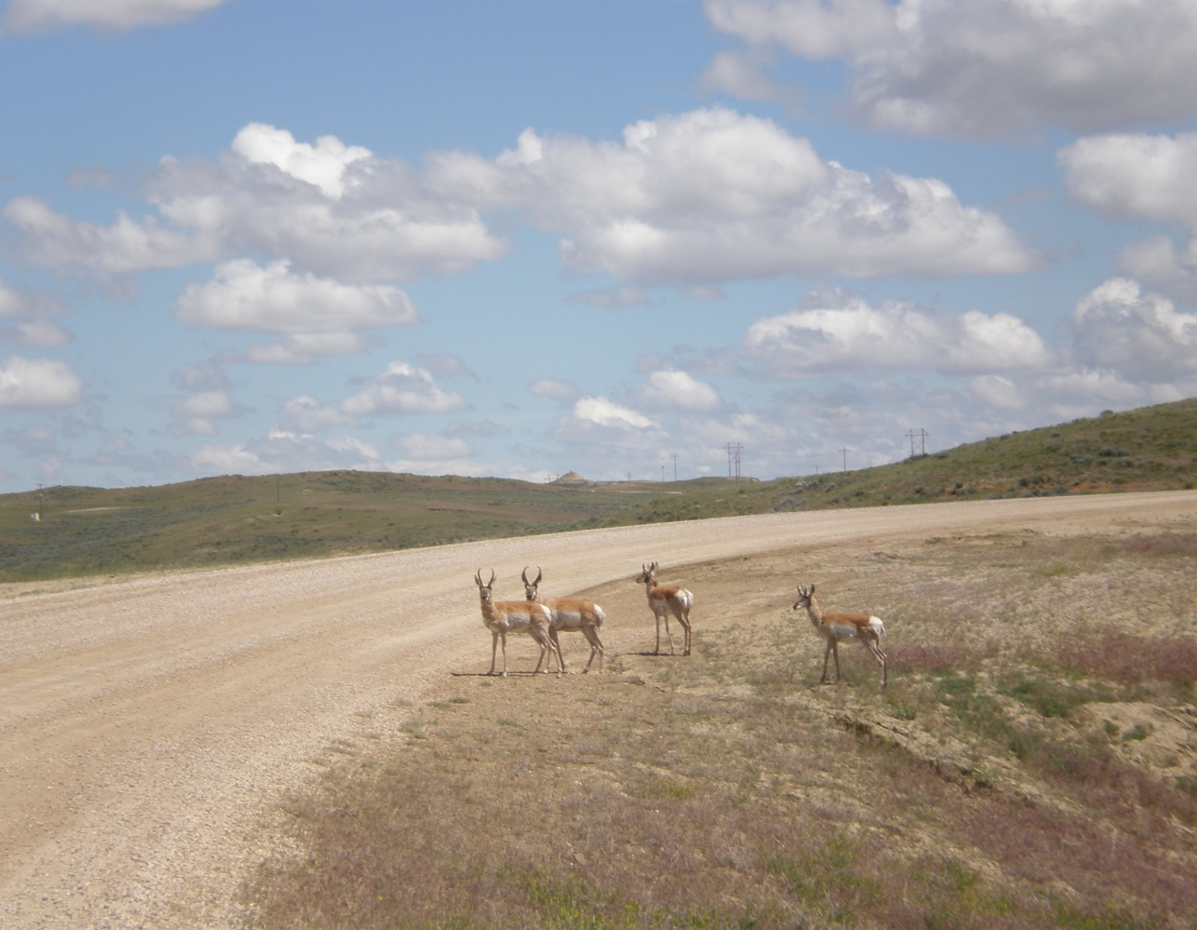
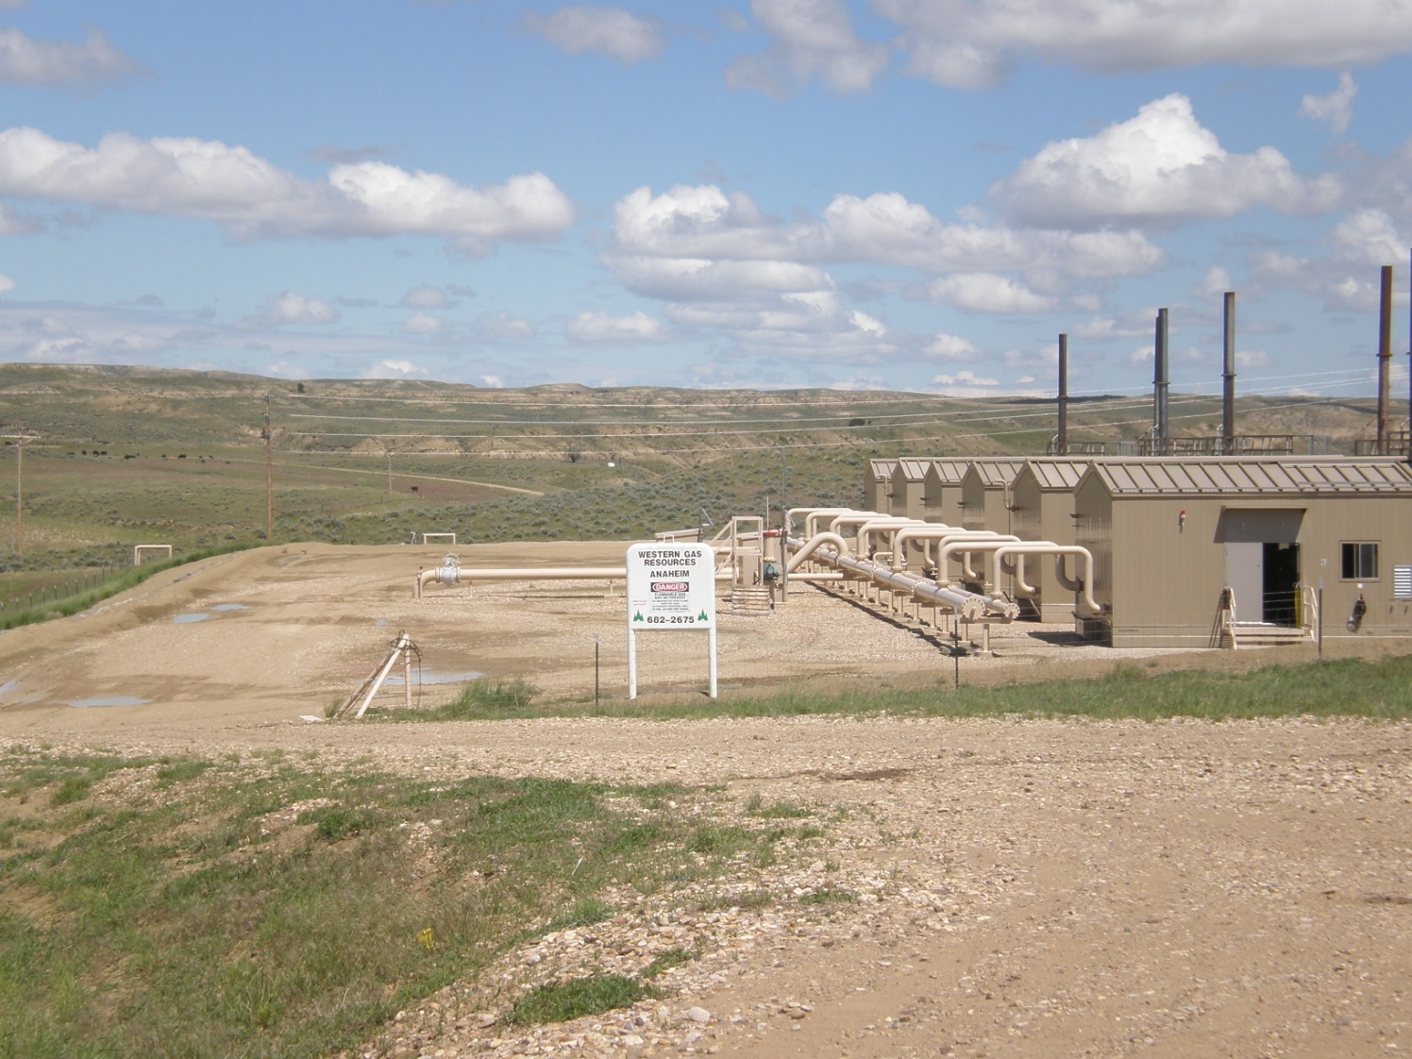
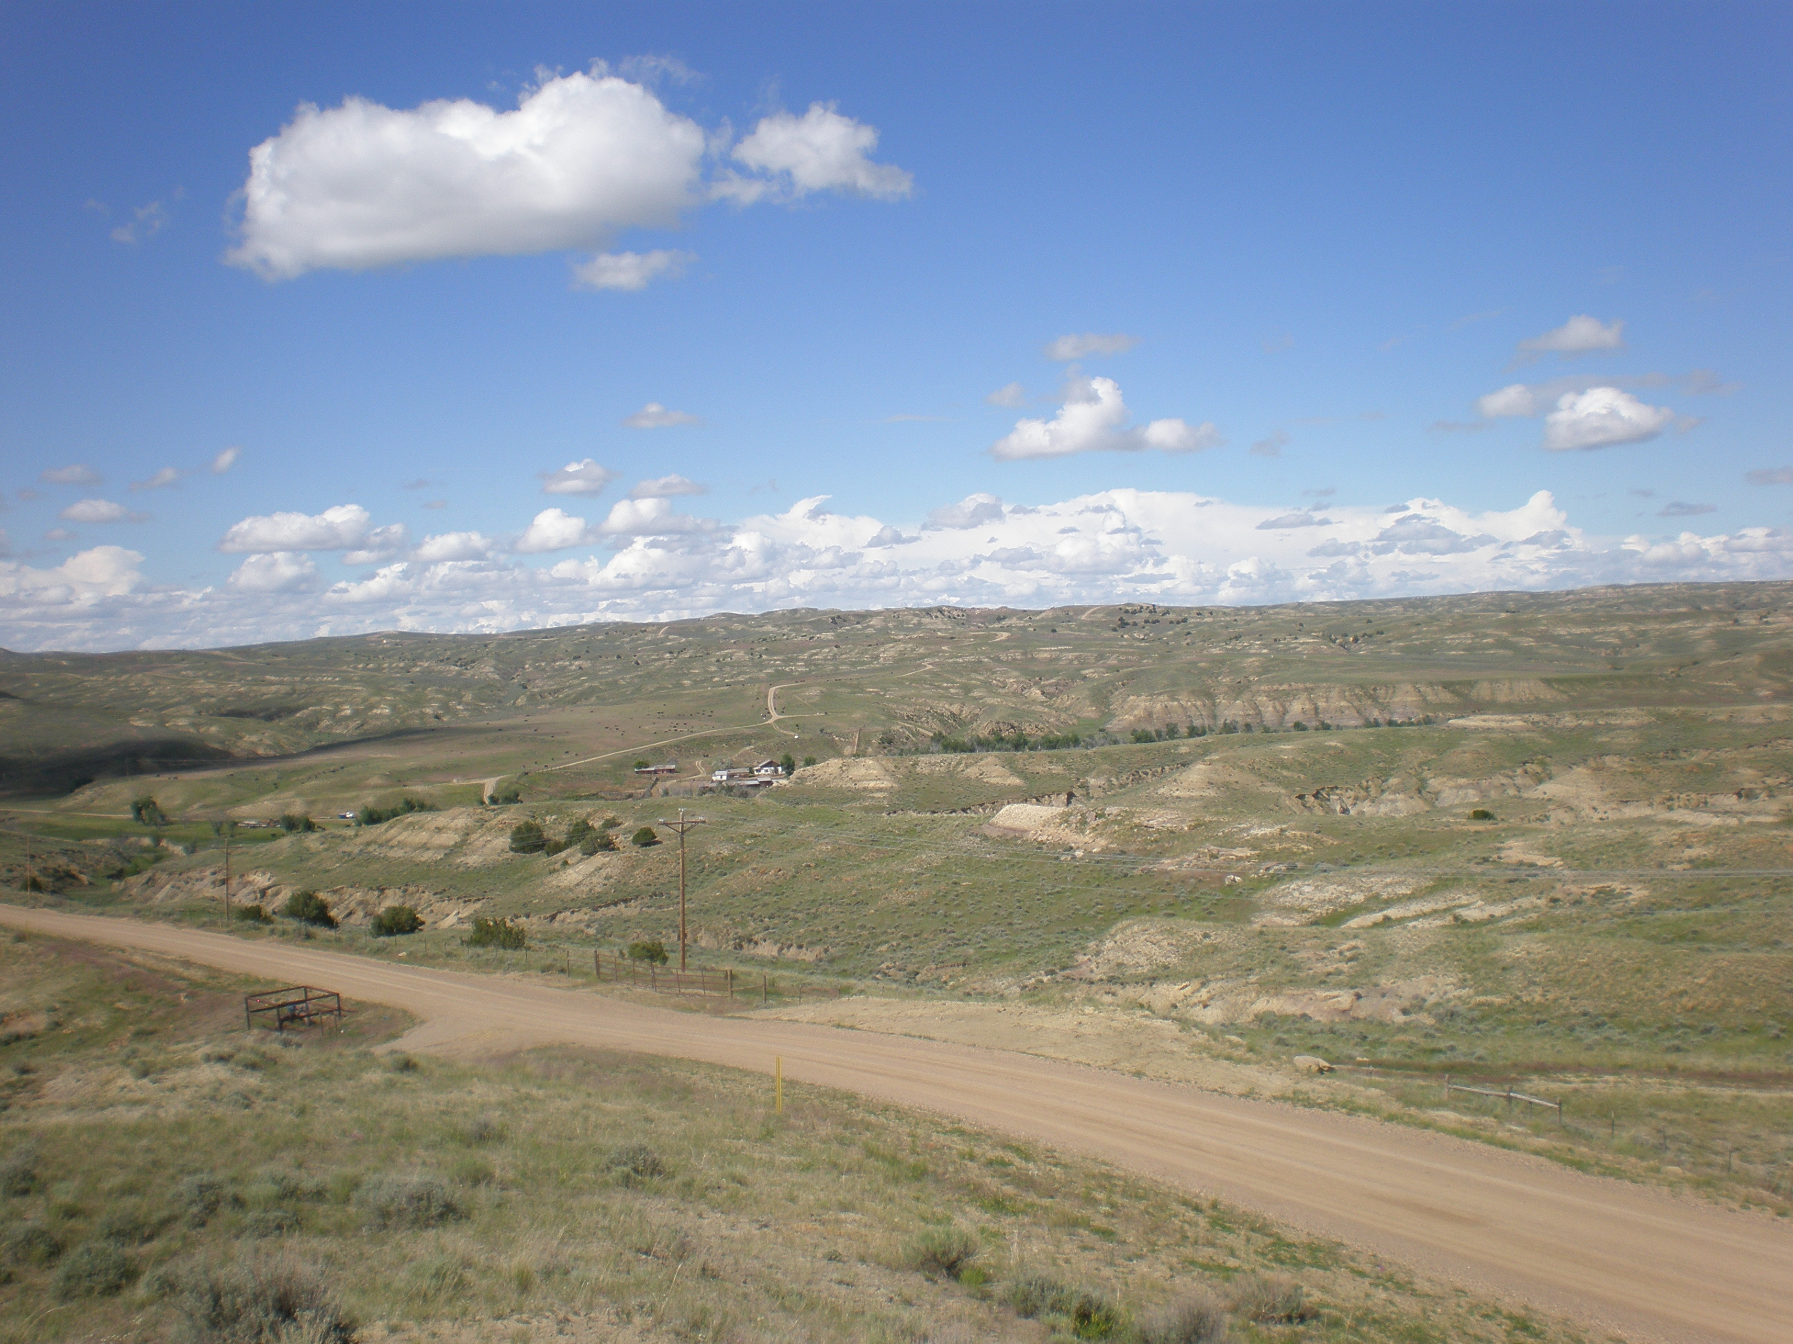
One Project, Many Goals
Lidar and Hyperspectral Imagery collected for DOE project
Goals
NRCS
ARS
WVU
Soil Survey: Information about badlands/misc. areas
WVU: assess hyperspectal imagery, model hydrology and test accuracy of Lidar
Consv.: Sage grouse habitat
ARS: assess impact of roads on rangeland health
Coal bed methane extraction

Slide 43
Many Goals – General Sampling
Latin hypercube sampling (LHS), a stratified-random procedure, provides an efficient way of sampling variables from their distributions
Latin square with more dimensions

Slide 44
Latin Square (2 blocking factors: columns and rows)
 |  | Columns
Rows | trt | 1 | 2 | 3 | 4
 | 1 | A | B | C | D
 | 2 | C | D | A | B
 | 3 | D | C | B | A
 | 4 | B | A | D | C

Slide 45
How to apply treatments so that there’s no bias?
Distance from windbreak
1x 2x 3x 4x
Summit
Shoulder
Backslope
Footslope
A | B | C | D
C | D | A | B
D | C | B | A
B | A | D | C

Slide 46
Latin Square observational – combinations of factors
Conditioned – only combinations that occur in reality are selected
 |  | slope
LC |  | 0 - 2 | 2 - 5 | 5 - 9 | 9 - 14
 | Pasture |  | X | X | X
 | Crop | X | X | X
 | Urban | X | X
 | Wetland | X | X
 |  | slope
LC |  | 0 - 2 | 2 - 5 | 5 - 9 | 9 - 14
 | Pasture | X | X | X | X
 | Crop | X | X | X | X
 | Urban | X | X | X | X
 | Wetland | X | X | X | X

Slide 47
cLHS – conditioned Latin Hypercube Sampling
Optimization problem (how do we select samples in a way the best represents the environment)
Attach environmental covariates to x,y locations (points)
Select points at random and compare them to the real distribution then accept point or try again
Repeat (iterations to determine best fit of samples selected vs. environmental covariates)

Slide 48
Conditioned Latin hypercube sampling
Conditioned LHS is an optimization problem: given N sites with ancillary data (X), select n sample sites (n << N) so that the sampled sites x form a Latin hypercube, or the multivariate distribution of X is maximally stratified.
For continuous variables, first we define the sample size n. Each component of X (size N × k) is divided into n equally probable strata based on their distribution, and x (size n × k) is a sub-sample of X. We define matrix η which counts the number of x that fall into each of the defined stratum:
where the rows represent the strata s₁, … s_{n} and the columns represents variable X₁, … X_{k}.
A true LHS will have values of 1 for all cells of matrix η. The challenge is to find x that has the value of η close or equal to 1.
The cLHS algorithm (from Matlab vervsion) as follows:
(1) Divide the quantile distribution of X into η strata, and calculate the quantile distribution for each of the variables, q^{i}_{j},..., q^{i+1}_{j} , for j =1, .. k, and i = 1, .. n+1. Calculate C, the correlation matrix for X.
(2) Pick n random samples from N,. x (i = 1, … n) are the sampled sites and r (i = 1, … N – n) is the reservoir or unsampled sites.
Calculate T, the correlation matrix of x.
(3) Calculate the objective function:
For continuous variables:
,
where
is the number of xj that fall in between quantiles (q^{i}_{j} andqi+1j.
To ensure that the correlation of the sampled variables will replicate the original data, we add another objective function:
where c is the element of C, correlation matrix of X, and t is the equivalent element of T, correlation matrix of x.
The overall objective function is:
O = w₁O₁ + w₂O₂
where w is the weight given to each component of the objective function, for general applications w is set to 1 for all components of the objective function.
(4) Perform an annealing schedule (Press et al., 1992):
Metro=exp[-Δ0/T],
where ΔO is the change in objective function, and T is a cooling temperature (between 0 and 1) which is decreased by a factor tfac at each iteration.
(5) Generate rand a uniform random number between 0 and 1, if rand < Metro, accept the new values, otherwise discard changes.
(6) Try to perform changes: Generate a uniform random number rand.
If rand < p,
Pick a sample randomly from x and swap it with a random site from reservoir r.
Else,
Remove sample(s) from x which has the largest ()1ijjjqxqη+≤< and replace it with random site(s) from the reservoir r.
End if.
The value of p is between 0 and 1 showing the probability of the search being a random search or systematically replacing the samples that worst fit the strata.
(7) Go to step (3)
Repeat the steps (3) to (7) until the objective function value falls beyond a given stopping criterion or for a defined number of iterations.
The final sample will represent a true or approximate Latin hypercube of the feature space whereby the distribution and multivariate correlation will be preserved.
Choice of tfactor:
tfactor takes a value between 0 and 1. If the value is small (close to 0) then it only accepts value that has lower value of O at each iterations, value close to 1 means it will always accept new iteration values (random search).

Slide 49
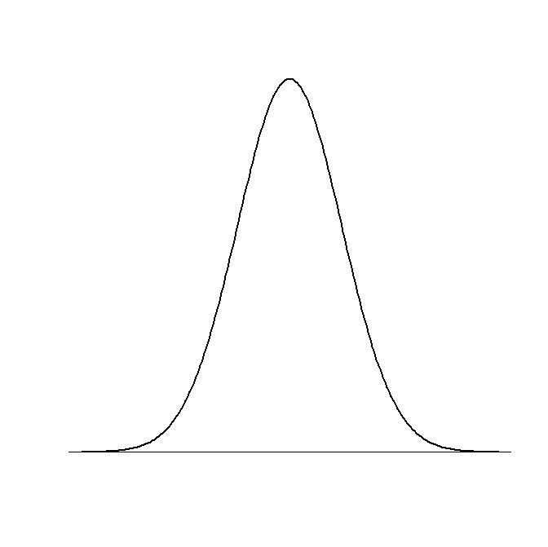
cLHS (how it works)
Latin Hypercube:
Divides probability distribution of all variables
Equally probable intervals
Randomly samples inside intervals
Combines samples
Samples form a Latin Hypercube
But....
Sample combination may not
actually occur in data
Equally probable intervals
Variable 1
Variable 2
Notes:
Because combinations of values chosen may not actually occur in the feature space (i.e. in the real world) a Latin Hypercube is constructed and then randomly selected values are chosen and checked to see if these samples meet the criteria of a Latin Hypercube. This is accomplished using an objective function and annealing schedule.

Slide 50
Notes:
The Normalized Difference Vegetation Index (NDVI) is an index of plant “greenness” or photosynthetic activity, and is one of the most commonly used vegetation

Slide 51
Notes:
PDF (probability density function) of NDVI in this watershed.
In probability theory, a probability density function (PDF), or density of a continuous random variable, is a function that describes the relative likelihood for this random variable to take on a given value.

Slide 52
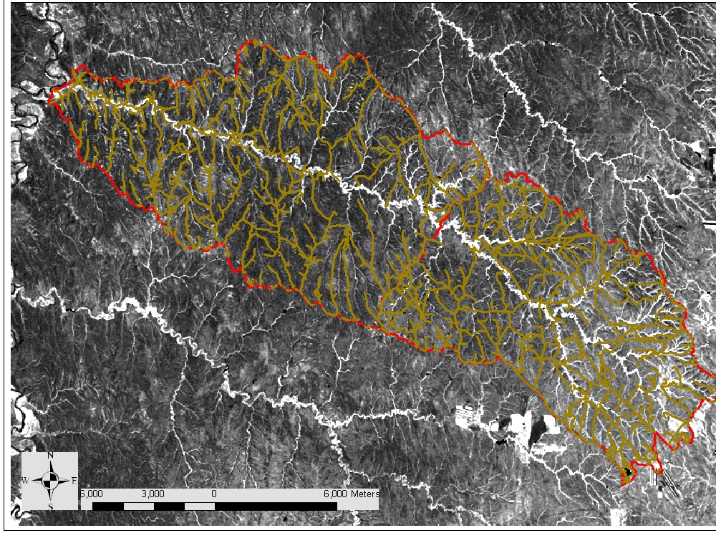

Slide 53
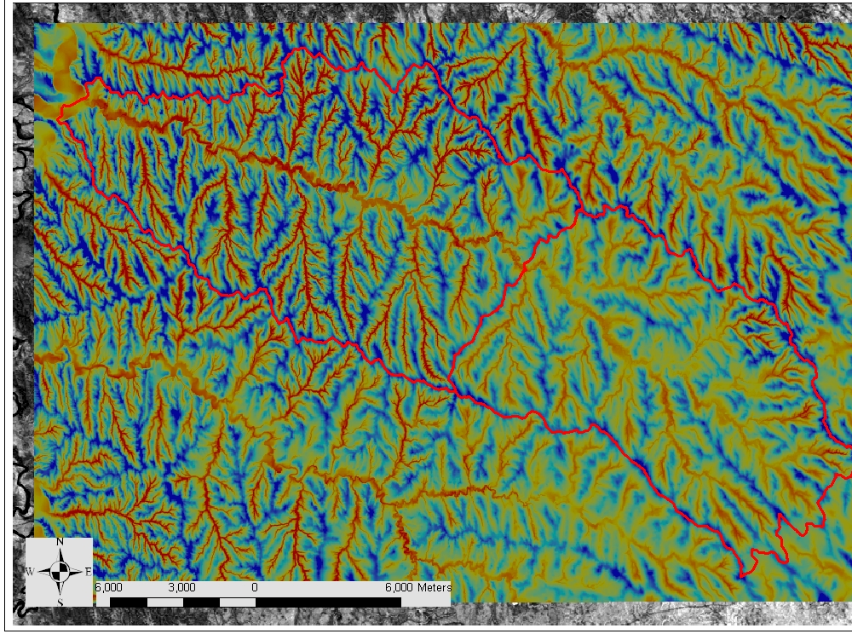

Slide 54
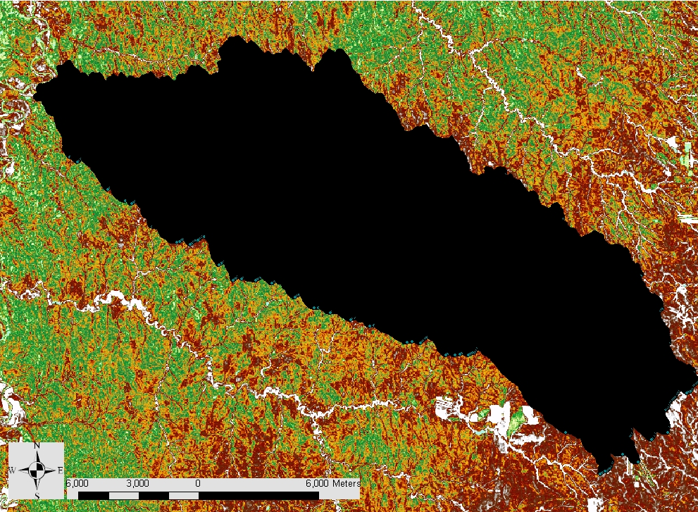

Slide 55
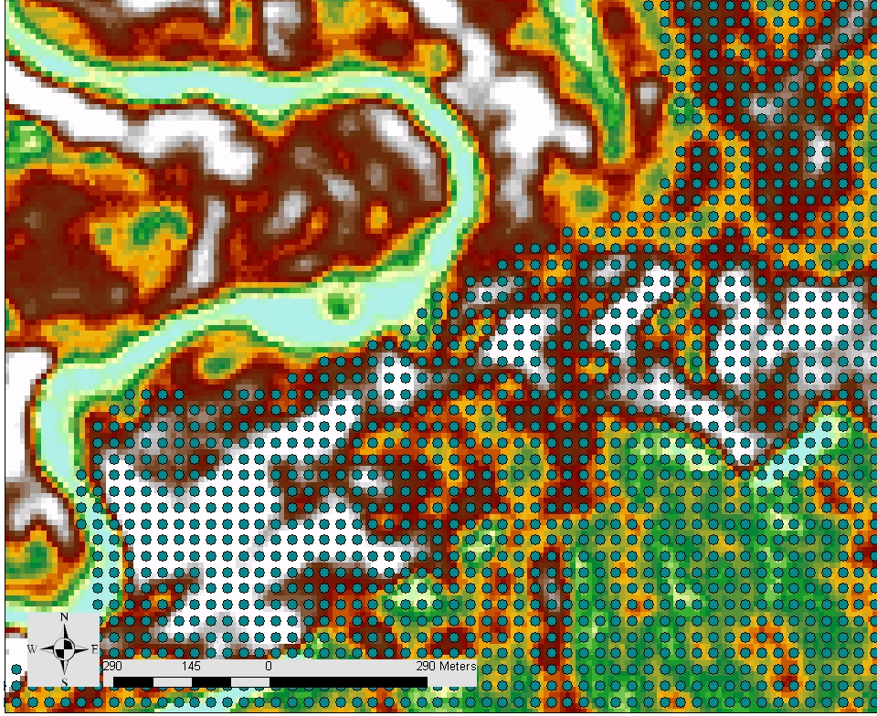
ID | X | Y | NDVI | TWI | TPI | STRM_PWR | LS_5-2 | LS_5-7 | roads
1 | 418344.490 | 4887912.940 | 153 | 5.18 | 5.72 | 0.10 | 0.52 | 0.07 | 32.01
2 | 418374.490 | 4887912.940 | 156 | 5.25 | 4.21 | 0.36 | 0.55 | 0.08 | 7.07
3 | 418404.490 | 4887912.940 | 155 | 5.27 | 4.33 | 0.35 | 0.50 | 0.06 | 5.00
4 | 418254.490 | 4887882.940 | 148 | 4.99 | 7.50 | 0.38 | 0.44 | 0.05 | 96.17
5 | 418284.490 | 4887882.940 | 150 | 5.11 | 9.59 | 0.11 | 0.51 | 0.05 | 69.46
6 | 418314.490 | 4887882.940 | 151 | 4.90 | 7.24 | 0.29 | 0.53 | 0.06 | 42.72
7 | 418344.490 | 4887882.940 | 150 | 5.06 | 3.85 | 0.64 | 0.54 | 0.07 | 15.81
8 | 418374.490 | 4887882.940 | 156 | 5.35 | 2.25 | 0.63 | 0.54 | 0.07 | 7.07
9 | 418404.490 | 4887882.940 | 156 | 4.58 | - | 0.85 | 0.51 | 0.06 | 29.15
10 | 418434.490 | 4887882.940 | 146 | 4.41 | 2.46 | 0.39 | 0.48 | 0.05 | 14.14
11 | 418464.490 | 4887882.940 | 143 | 5.63 | 4.26 | 0.14 | 0.46 | 0.05 | 5.00
12 | 418014.490 | 4887852.940 | 153 | 4.74 | 2.05 | 0.34 | 0.52 | 0.09 | 10.00
Notes:
Optimum index factor

Slide 56
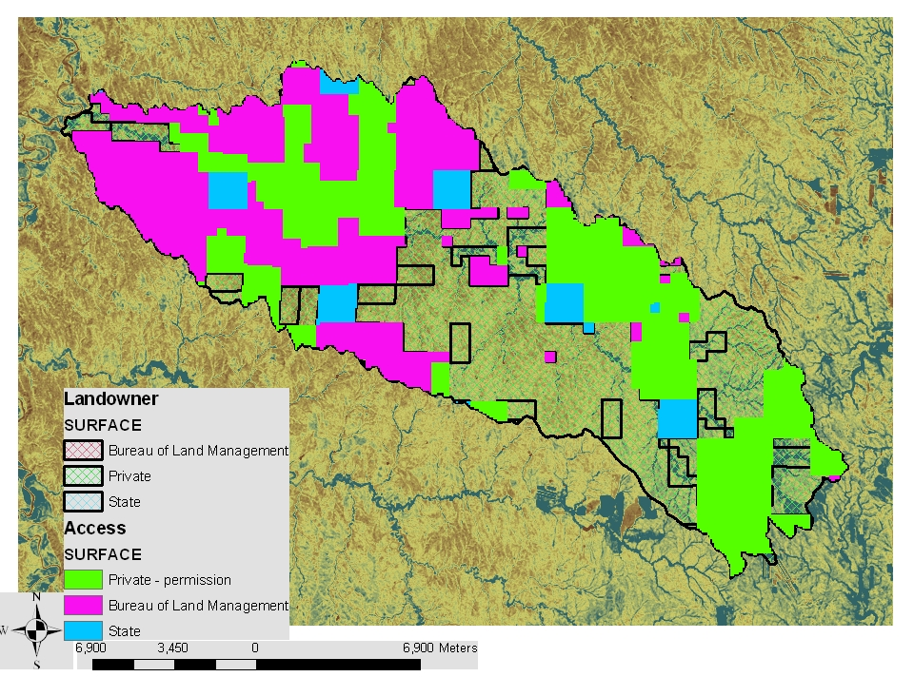

Slide 60
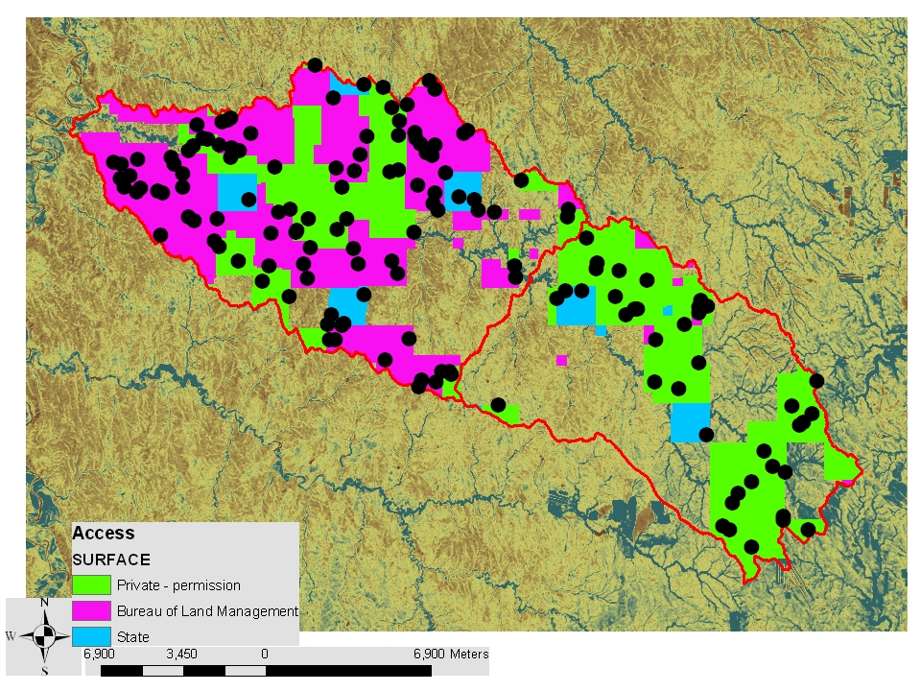

Slide 61
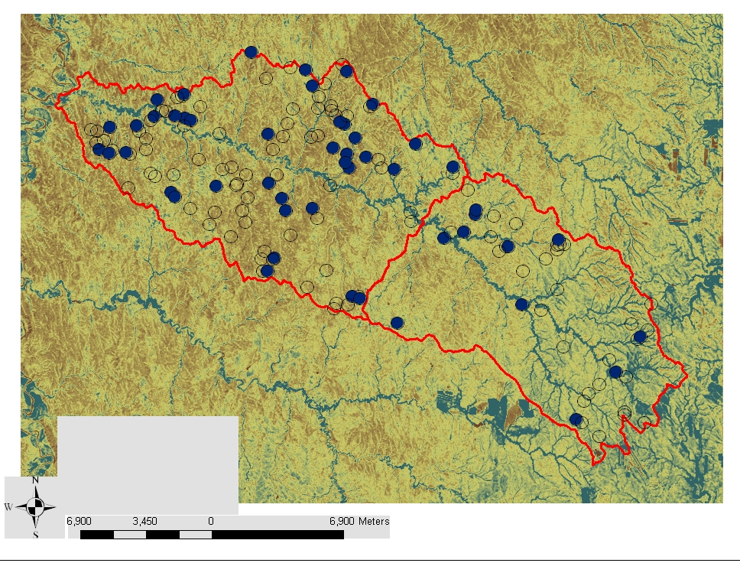

Slide 62
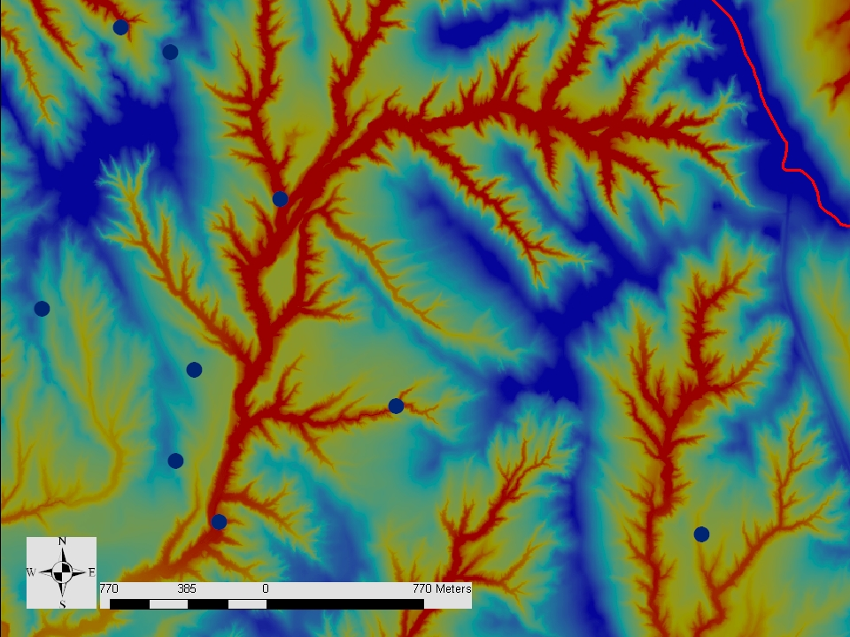

Slide 63
Summary cLHS
Representative sample of multiple variables – meets multiple goals
Statistically unbiased
Can minimize the number of samples
As few as 5 samples gave a reasonable representation of some environmental covariates
Uses environmental covariates that are becoming commonly available

Slide 64
Practical cLHS
Brungard and Johanson 2015. The gate’s locked! I can’t get to the exact sampling spot … can I sample nearby? Pedometron http://www.pedometrics.org/Pedometron/Pedometron37.pdf
Roudier, Hewitt, and Beaudette 2012. A conditioned latin hypercube sampling algorithm incorporating operational constraints. In book: Digital Soil Assessments and Beyond: Proceedings of the 5th Global Workshop on Digital Soil Mapping, Publisher: CRC Press, Editors: Budiman Minasny, ‎Brendan P. Malone, ‎Alex B. McBratney, pp.227-232 https://www.researchgate.net/publication/260516791_A_conditioned_Latin_hypercube_sampling_algorithm_incorporating_operational_constraints

Slide 65
Questions?

Slide 66
How Many Samples
Traditional ‘one-way’ MDD approach
Comparison of total and sampled distributions

Slide 67
Sample Size Requirements
depend on:
MDD - minimum detectable difference
Variance (multi-scale)
Error and Precision Rates – alpha, power
This can include things like desired confidence level

Slide 68
MDD
Functionally important differences
Not a lot of information; can be set by expert knowledge
Targets or Goals – change over time
Contract to sequester 1 Mg ha⁻¹ C
Set to a % of the mean
5% or 50% etc. difference

Slide 69
Multiscale Sampling Requirements
Can be solved for N or MDD.
Actual vs. Desired MDD
Number of samples needed to detect change at the plot scale
N = ((Z _{alpha/2}+ Z_{1-power})² *S_{res}²*2*(1-rho))/MDD²
Number of samples needed to detect change over the entire project area
N = ((Z _{alpha/2}+ Z_{1-power})² * S_{test}²*2*(1-rho))/MDD²
MDD that can be detected as sampled, N is predetermined
MDD that you would like to detect, used to set N
Variance
MDD
N =
Variance
N
Variance
MDD
MDD=
N =

Slide 70
MSSRET Multi-scale Sampling Requirements Evaluation Tool
Excel based tool that calculates sample size requirements based on
Variance (within and between plots)
MDD: minimum detectable difference or change
Tool reports the number of samples needed to detect change at the plot scale and the number of samples and plots needed to detect change at the regional or project scale
Download this tool and additional training materials at
http://www.landscapetoolbox.org/mssret/MSSRET.html
Web-based Tool
http://www.nrcs.usda.gov/wps/portal/nrcs/detail/soils/home/?cid=nrcs142p2_053372

Slide 71
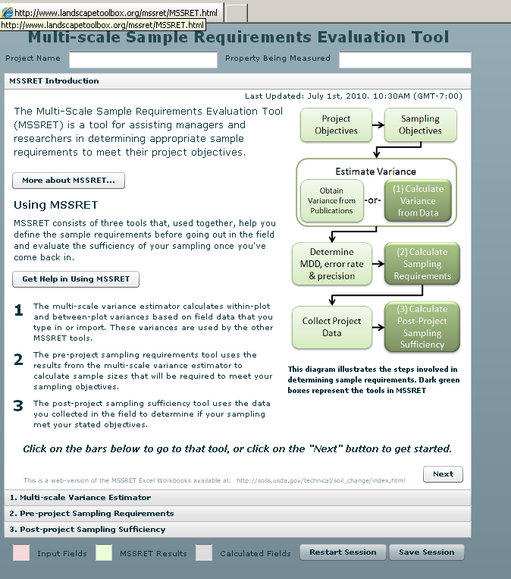
Web Based MSSRET
The Landscape Toolbox
Sample Design Tools
Sampling Design for Rangeland Monitoring and Assessment
http://www.landscapetoolbox.org/mssret/MSSRET.html

Slide 72
Compare Distributions
Examine boxplots, strip charts or probability distribution functions
All known values
Vs.
Sampled values
WY-Beaver Creek example
https://github.com/ncss-tech/stats_for_soil_survey/tree/master/presentations/sampling/pdf_example
This is not how I would do this now – BUT
we have a record of how the analysis was done,
So if someone wants to revisit, recreate or update
– it can be done relatively easily.

Slide 74
Online Chapters
Work through sampling chapter (3)
Good concepts to know as you move forward in your career

Slide 75
Complete cLHS example
https://github.com/ncss-tech/stats_for_soil_survey/tree/master/presentations/3_sampling/sampling_cLHS_example
cLHS_sampling_R_example.pptx
Select cLHS samples from Haiti dataset
Create a PDF graph of at least one variable used in sample selection

Slide 76
Implement Sampling in R
Andrew will guide you through the sampling.rmd

